Slide 1
README
BURN AFTER READING
about_SlideDeck
The actual presentation starts with slide 6 ("Session title"). The first five slides have a purely organisational purpose. During the break before your session, you should start the presentation with slide 2 ("Next up"), so that the audience knows that they are in the right room. It's fine if you start chatting with the audience during this break, but we need a precise starting point for your presentation in terms of editing your video. That means:
The recording of your presentation will start after the countdown. Please (RE)START talking after the countdown, not during it! Otherwise your recording will start with a half sentence.
It is not necessary to explicitly signal to the PA operator, this is your signal!
Finally, do you have to use this slide deck? No, you are free to present the way you like it. But you are asked to use the intro slides: countdown, session title, sponsor slide. Beyond that, use what is good for the cause – from no slides to sketches from your children, from Jupyter to $youNameIt.
You will find additional information in the notes below.
Sincerely, your hosts!
Dear Speaker, we are thrilled and honored to have you with us in Malmö in 2025. Take your time and read this before you prepare your session.
Since most of you have been with us before, you will already know a lot about PSConfEU. You know that we try to capture all sessions carefully and publish your work on YouTube. There are a few easily avoidable stumbling blocks that we would like to draw your attention to:
Your screen resolution should be 1920x1080 px (FullHD)
You should provide a full size HDMI socket
Mirror your screen
Disable "Presenter View" in PowerPoint
Using MAC or Surface book? Be aware of HDCP!
Disable the ‘Night Light Mode’
Notes:
The fine print (additional information)
Why should you care about HDCP?
"High-bandwidth Digital Content Protection (HDCP) is a form of digital copy protection developed by Intel Corporation to prevent copying of digital audio and video content as it travels across connections. Types of connections include DisplayPort (DP), Digital Visual Interface (DVI), and High-Definition Multimedia Interface (HDMI), as well as less popular or now deprecated protocols like Gigabit Video Interface (GVIF) and Unified Display Interface (UDI)."
https://en.wikipedia.org/wiki/High-bandwidth_Digital_Content_Protection
Some notebooks ignore the HDCP standard, some vendors comply with the standard. Apple and Microsoft are somehow famous for strictly following the HDCP guidelines. Sadly, we will not be able to guarantee, that your session can be recorded in the latter case.
But you can do simple things, to overcome these problems. It is also very likely that you presented with your notebook before. So you will know, if this worked fine.If you are in doubt and if the agenda allows, try a dry-run a day before and connect everything.
In general you can easily bypass HDCP restrictions with a cheap splitter (the cheaper the better), just like the one you see below. This is an example device that we bought for 16 euros (in Germany).
Ask us, we will lend you such a device.
Thorsten also gave a whole presentation about "Broadcasting yourself" - easy steps to record yourself and create a (backup) session recording on your own. If you want to invest your time and dive deeper, take a look at his recordings and notes:
https://vimeo.com/thorstenbutz/byourself
This is of course completely voluntary, but perhaps you will find it helpful.

Slide 2
Building robust CI/CD pipelines with GitHub Apps and custom automation
Emanuel Palm

Slide 3
3
3

Slide 4
2

Slide 5
1

Slide 6
Building robust CI/CD pipelines with GitHub Apps and custom automation
Emanuel Palm

Slide 7

Many thanks to our sponsors:

Slide 8
Story about public / private repo
Talk a little bit about automating repo actions and events
“Getting your code on GitHub is great. You can share your project with the world, you can automate your releases and deployments”

Slide 9





Emanuel Palm
Cloud Specialist @ Unwonted
💙 Everything-as-Code
📦 Makes modules & tools
📃 Fan of Open Source
☁️ Blogs at pipe.how
☕️ Runs arkanum.coffee
🏃🧗🥏🍰🧙
https://www.powershellgallery.com/packages/Bicep https://www.powershellgallery.com/packages/AzAuth https://www.powershellgallery.com/packages/AzBobbyTables

Slide 10
Agenda
GitHub Actions & Workflows
GitHub Apps
Tokens
Tips & Tooling
Live coding!
Not covering all the basics, feel free to ask questions!

Slide 11


What are we creating today?
🔁
PSConfEU2025-Core
PSConfEU2025-Internal

Slide 12
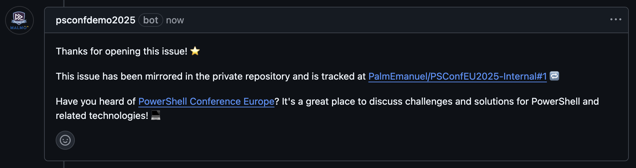

+1
PSConfEU2025-Core
PSConfEU2025-Internal

Slide 13

+1
+1
PSConfEU2025-Core
PSConfEU2025-Internal

Slide 14
+1
+1
PSConfEU2025-Core
PSConfEU2025-Internal

Slide 15
What are we creating today?
Demo 1 – Comment on new issues in same repo
Demo 2 – Also mirror issues to another repo
Show diagram with external webhook, but explain that we’re focusing on the GitHub part today and will skip the external endpoint (ie we need to store secrets in repos too)

Slide 16
Shedding Light on GitHub Actions
GitHub Actions is the CI/CD platform in GitHub
Building, testing, deploying
GitHub Actions (the platform, or “product”)
Workflows (has triggers, jobs and steps)
Actions (can be one or multiple steps)

Slide 17
Types of GitHub Actions
Public Actions on Marketplace
actions/upload-artifact@v4
Custom Actions
Docker Container
JavaScript Actions
Composite Actions

Slide 18
Example of GitHub Action
A picture of yaml with animation of trigger, jobs, steps etc

Slide 19
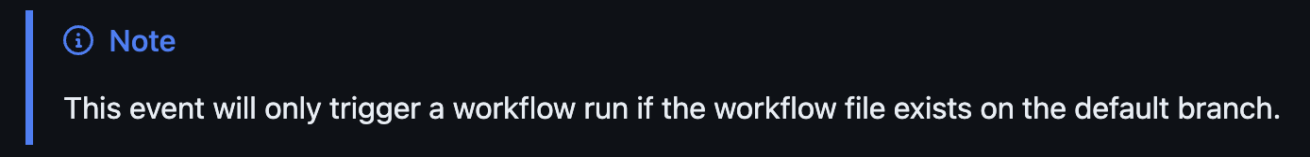
Tips & Tooling
You think you need access to repo secrets in PRs?
You don’t, never give anyone access to secrets from PRs
Secrets are not accessible from forks (ie are accessible in repo-internal PRs), but I think the experience for internal and external collaborators should be the same
Tooling
VS Code Extension
Default Branch (“main”)
Workflow Triggers
Environments
Approvals
Conditional Secrets & Variables
Strategy & Matrix
Fantastic for cross-platform module testing

Slide 20
Tips & Tooling
Workflows can be Status Checks for PRs

Slide 21
Workflow Context Variable(s)
Branch
Triggers
Events

Slide 22
GitHub Apps
OAuth Apps support on-behalf-of workflows (logging in as a user)

Slide 23
GitHub Apps vs OAuth Apps?
OAuth Apps support on-behalf-of workflows (logging in as a user)
GitHub Apps support both on-behalf-of and independent actions
Today we’re focusing on independent actions
But you can also do stuff like ”Login with GitHub”
Enhanced security
Fine-grained permissions
Access delegated per repository
Short-lived tokens
GitHub App installations are not tied to a user
Improves offboarding, no reliance on single accounts
Removes need for Personal Access Tokens

Slide 24
Token Types (we love them)
GitHub Personal Access Token (PAT)
GitHub Fine-Grained PAT
GitHub Actions Workflow Token (GITHUB_TOKEN)
GitHub App JWT (JSON Web Token)
Only for authenticating, used for requesting installation tokens
GitHub Installation Token
User Access Token
Preferably through GitHub Apps instead of OAuth Apps

Slide 25
Pre-reqs
Two empty repos created
App Created
Branches with finished demos ready
Recordings if possible, but likely too much to record

Slide 26
Demo 1
Demo part 1
Create action that posts comment
Show intellisense and tooling
Create workflow that uses action, trigger on issue created
Create issue and show comment
Demo part 2
Show how to create a GitHub App, show permissions
Show how to install an application
Run local code to show installations of pre-created application
Change workflow from part 1 to get app token for posting comment instead
Create issue and show comment

Slide 27
Break time!

Slide 28
Demo 2
Install app on second repository
New workflow in private repo
Triggers on a type called mirror
Creates an issue with a link to the issue in the payload
Posts repository_dispatch back to the public repo with type mirror
Change workflow in public repo
Change trigger to repository_dispatch
Post comment to issue from payload
New workflow in public repo
Trigger on new issue, post repository_dispatch to private repo with type mirror

Slide 29
Summary & Q&A
15 minutes

